Slide 1
How to Configure Email Notification in Jenkins
open Jenkins using the following URL: http://localhost:8080/ (if it is installed) on any browser and follow the below steps to configure Email Notification.
Click the ‘Manage Jenkins’ menu option displayed at the right side of the screen. You will be redirected to the ‘Manage Jenkins’ page, where you need to select the ‘Manage Plugin’ option.

Slide 2
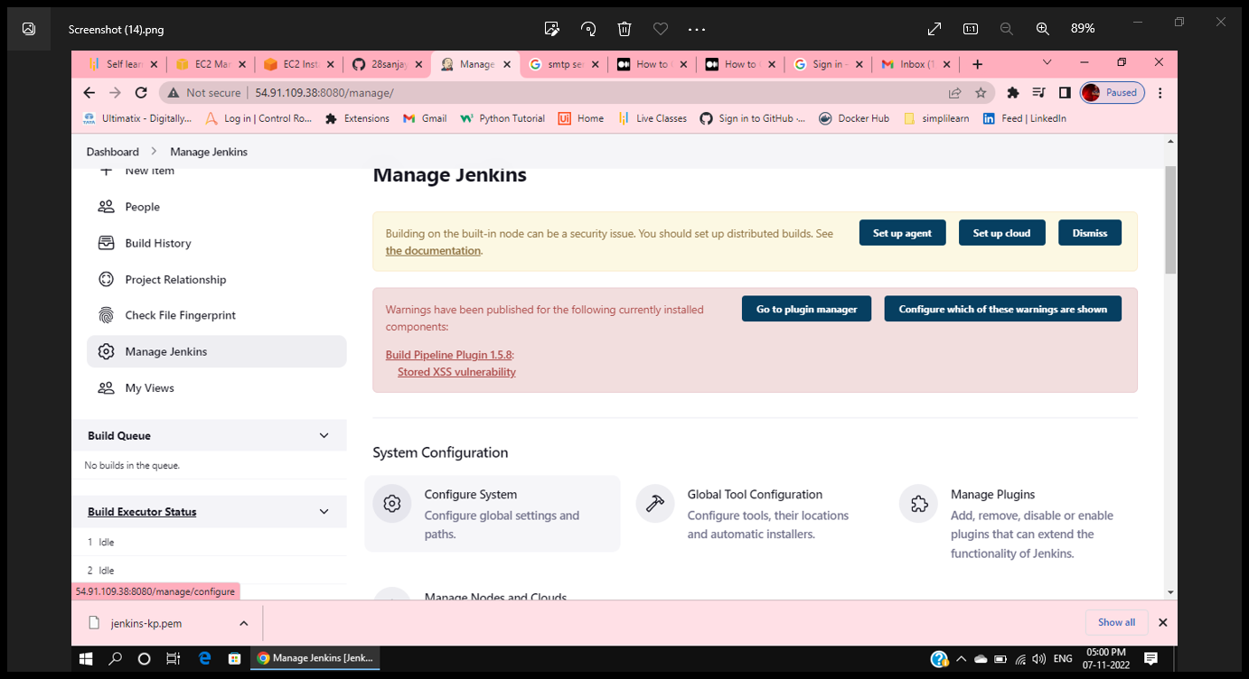
Dashboard > Manage Jenkins > Configure System

Slide 3
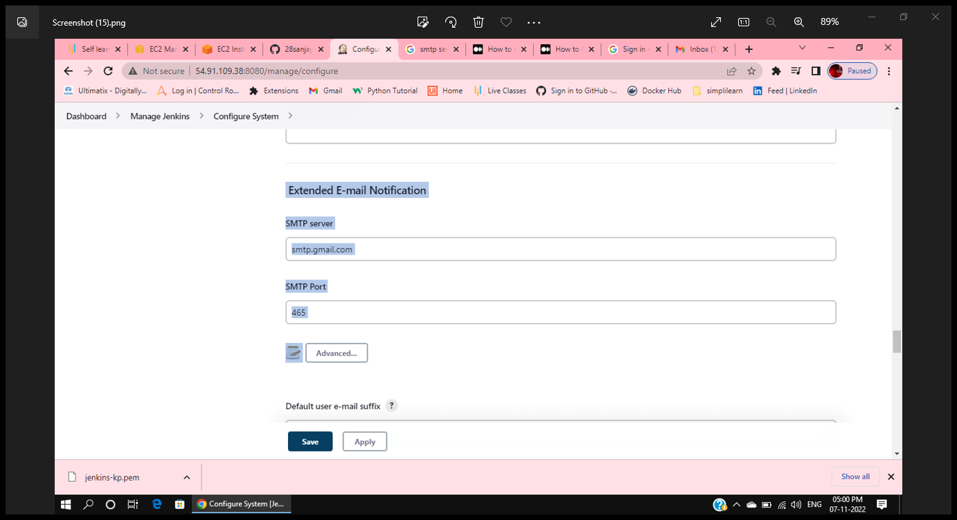
Scroll down to Extended E-mail Notification and set the fields as shown below.

Slide 4
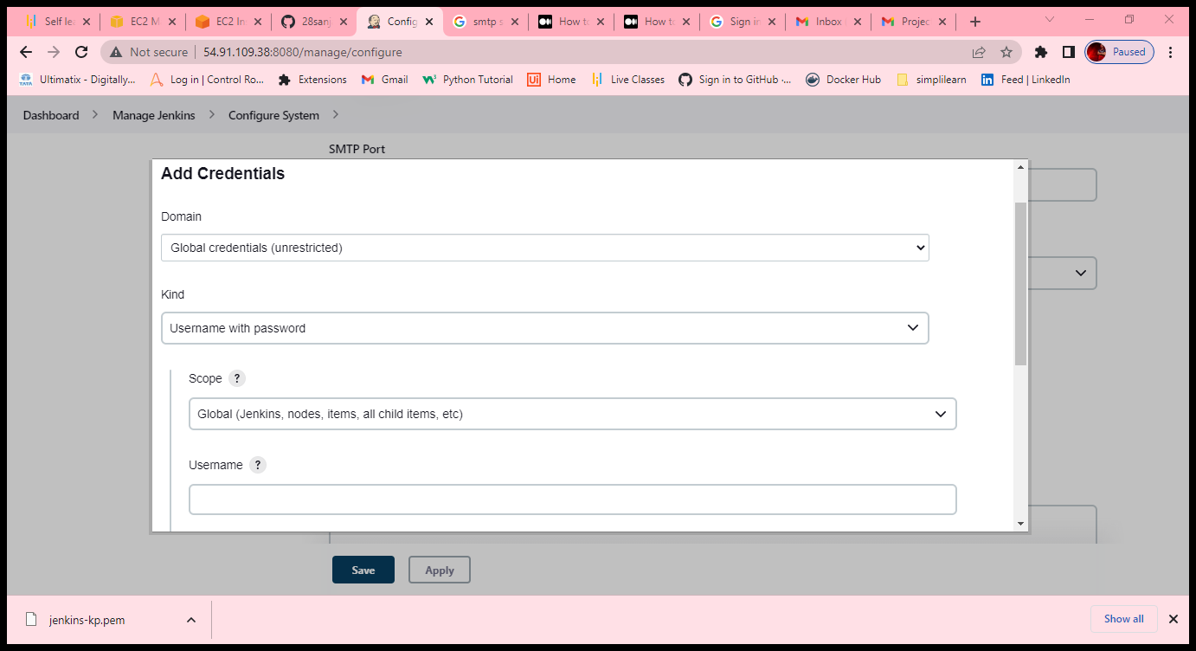
Credentials > +Add – Jenkins – username – user@gmail.com – passwd- email2 step verification 16 char passwd
Id – description – As – Email Credentials

Slide 5
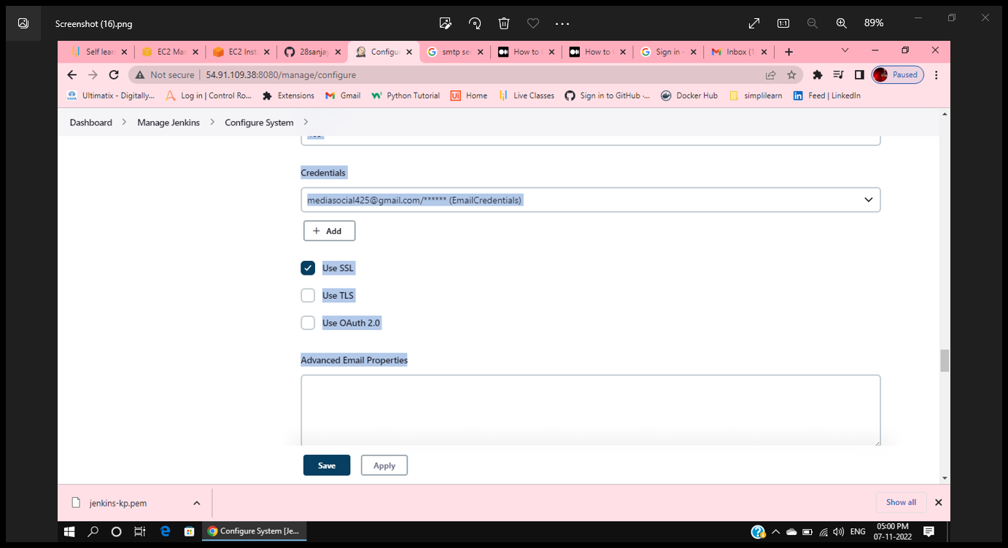
Checkout- Use SSL

Slide 6
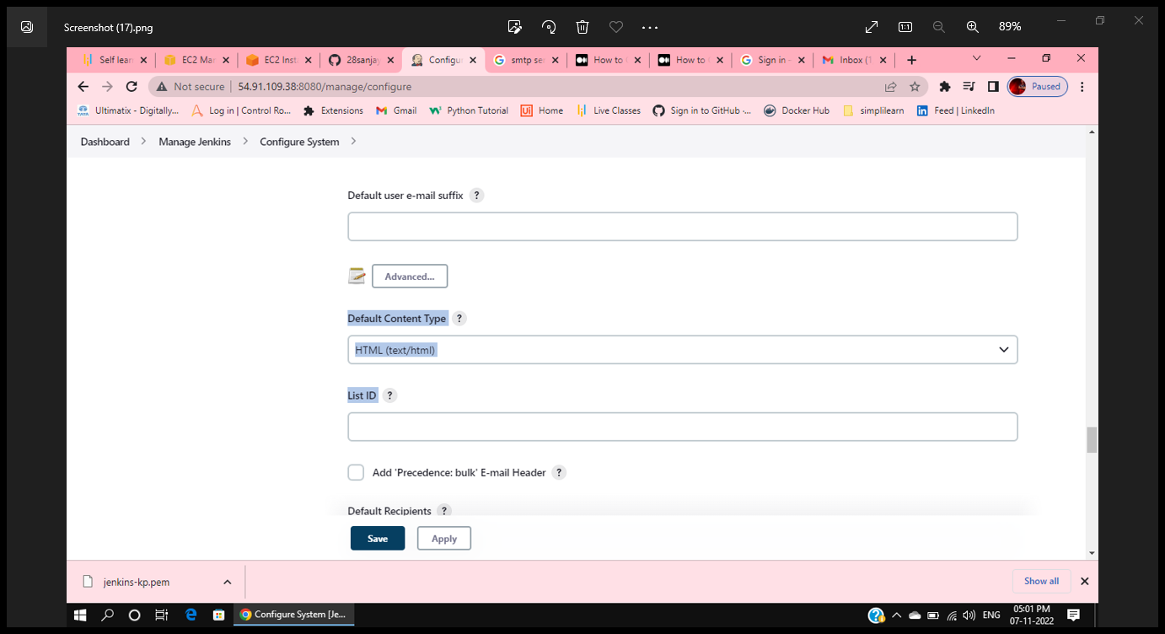
Default Content Type - HTML

Slide 7
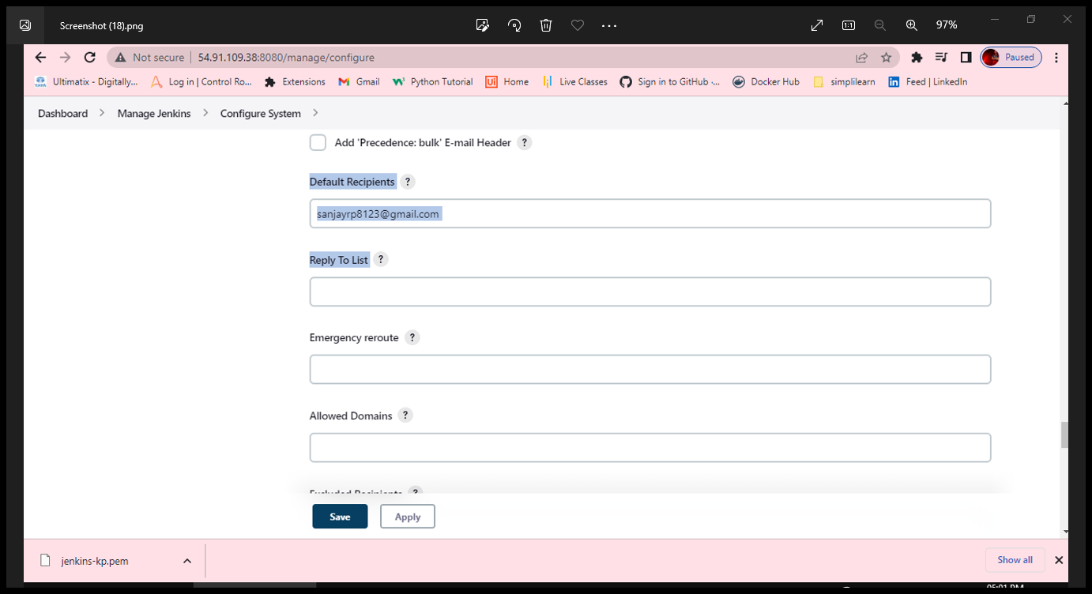
Default Recipient - choise

Slide 8
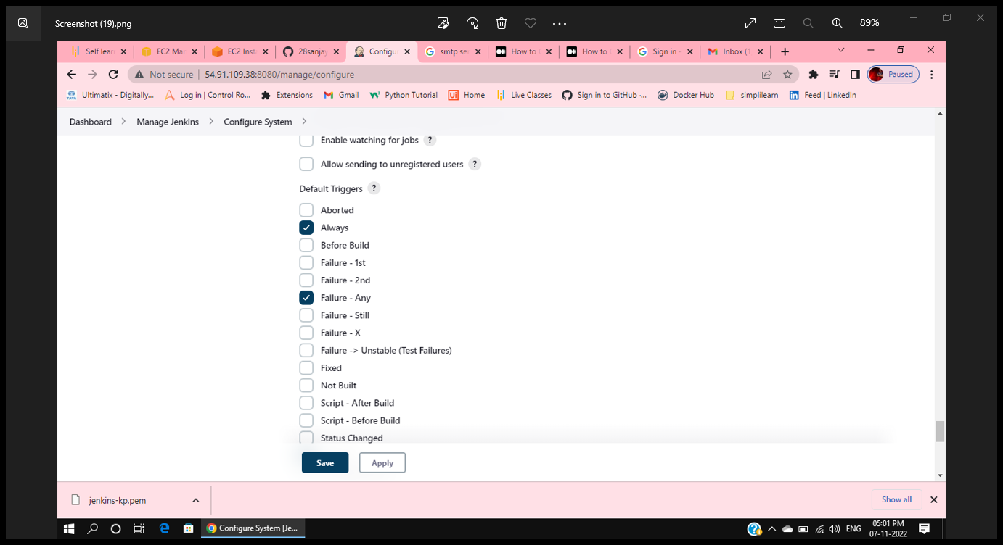
Default Trigger –
Always
Failure – any
Success
Save

Slide 9
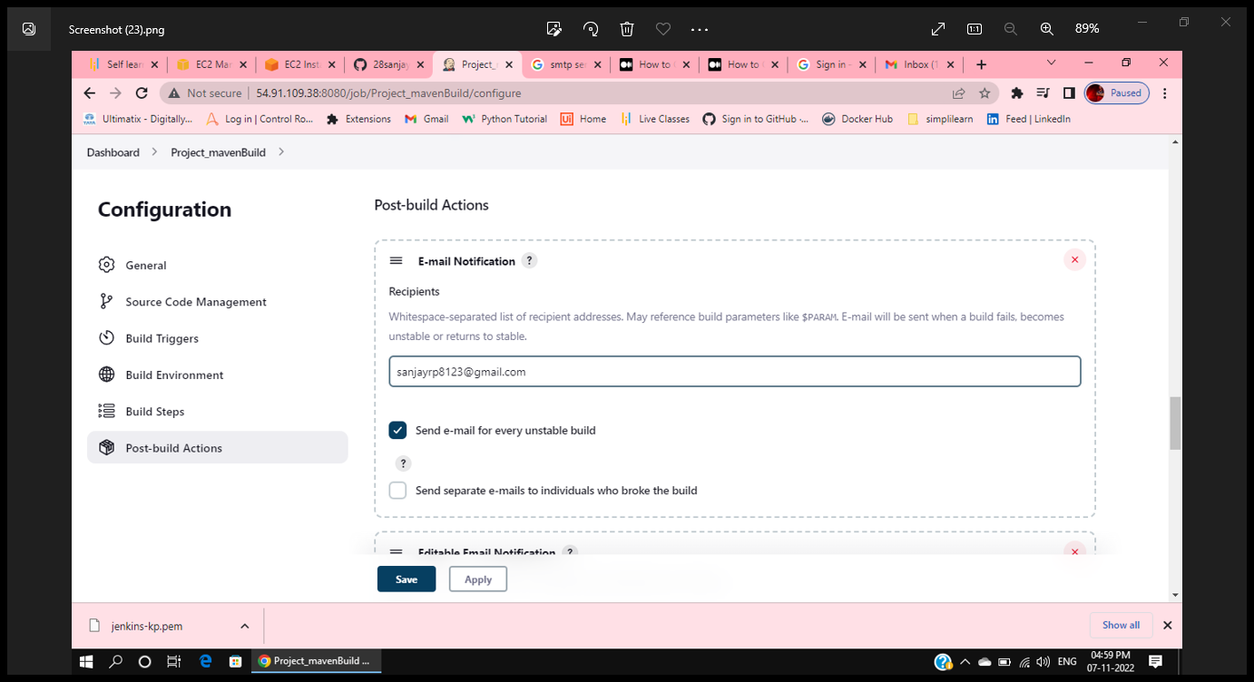
Move to Build – Post Build Action
Email – Notification
Checkout – send email for every unstable build

Slide 10
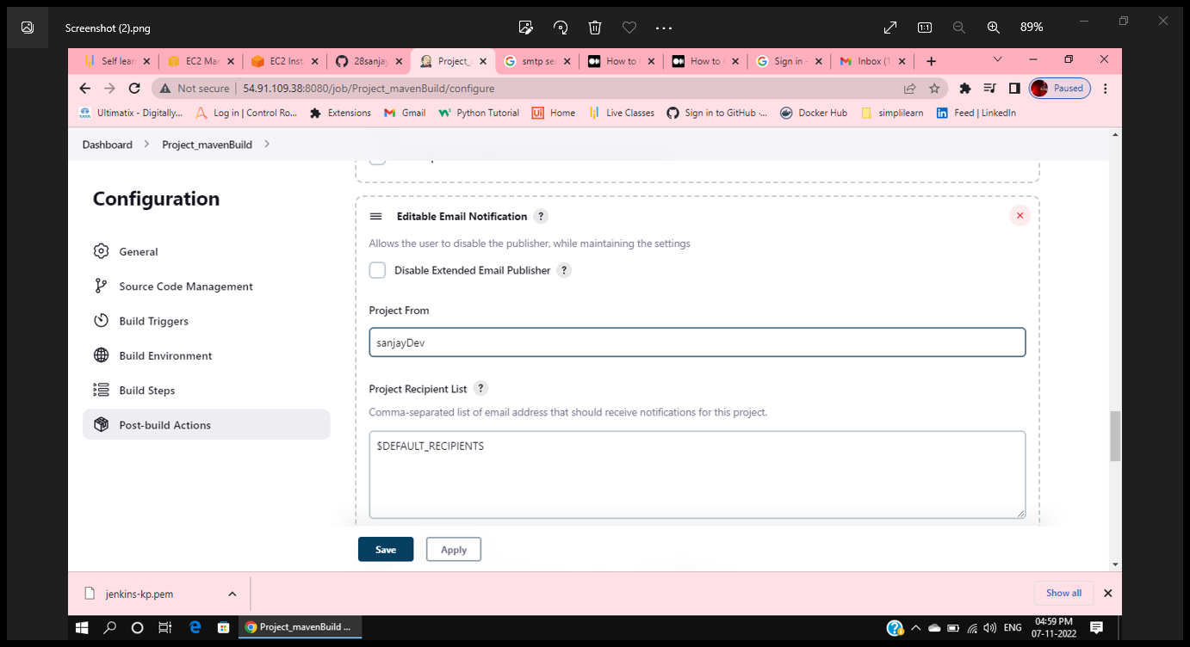
One more Post Build Action - > select – Editable Email Notification –from drop down
Attach Build Log?
- Compress and attach build log.
Keep everything default and save.

Slide 11
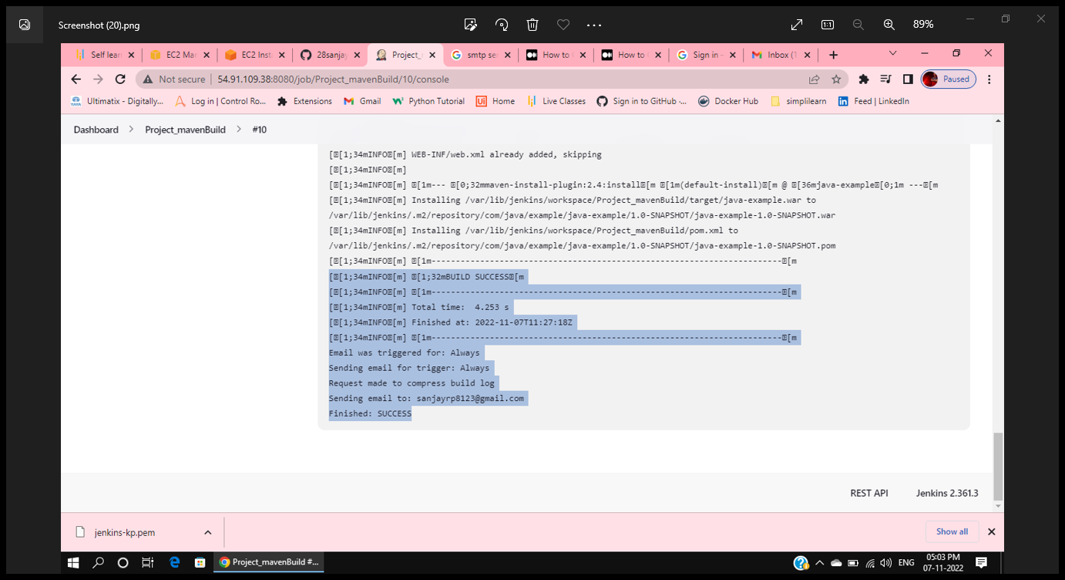
Run Build – once the build completes then we get a notification through email.

Slide 12
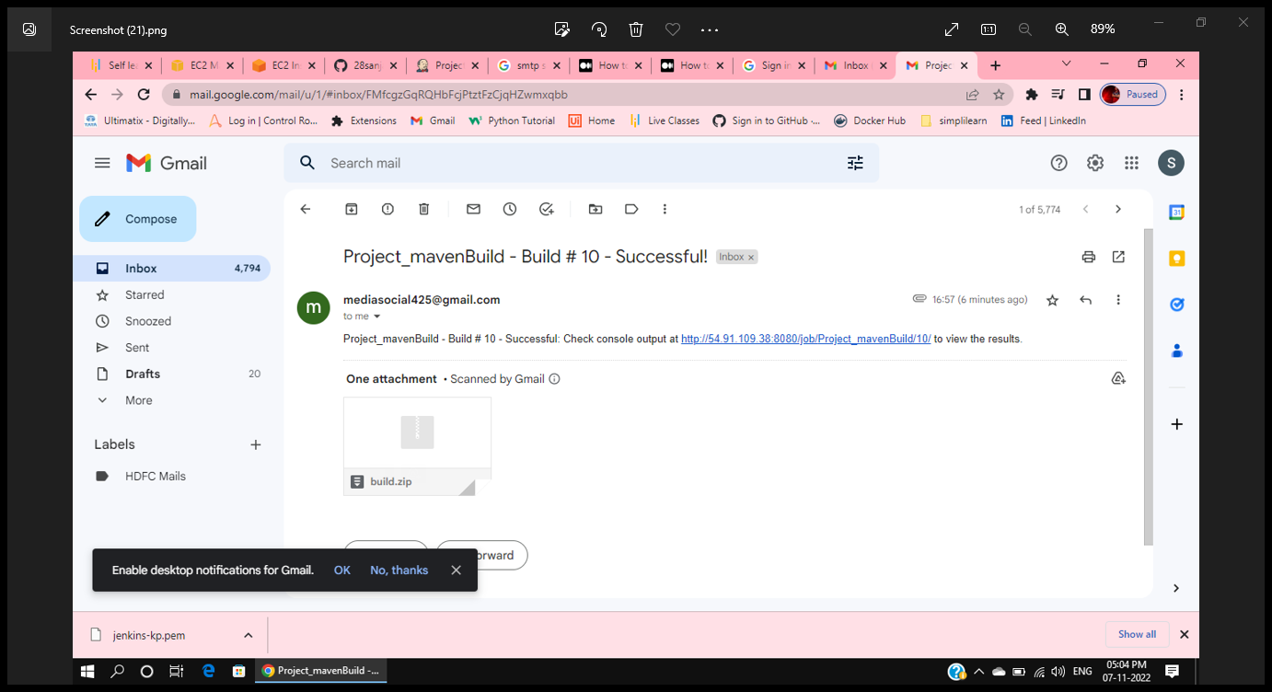
Received Email – Build successful.

Slide 13
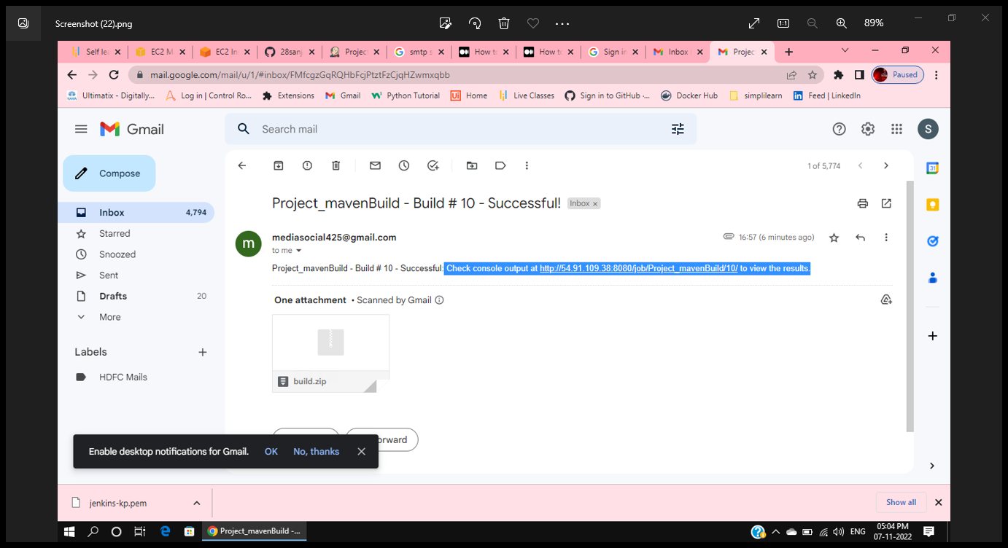
If We click the URL got in the email we directly redirect to Jenkins build.

